Slide 1
SC-400T00A Microsoft Information Protection and Compliance Administrator
Author name

Slide 2
Monitor and Investigate Data and Activities by using Microsoft Purview

Slide 3
Outline: Explore compliance in Microsoft 365
Explore compliance in Microsoft 365
Search for content in the Microsoft Purview compliance portal
Manage Microsoft Purview eDiscovery (Standard)
Manage Microsoft Purview eDiscovery (Premium)
Manage Microsoft Purview Audit (Standard)
Manage Microsoft Purview Audit (Premium)

Slide 4
Explore compliance in Microsoft 365

Slide 5
Agenda
Plan and Assess Regulatory Compliance
Create and Modify Custom Templates
Interpret and Manage Improvement Actions
Monitor Compliance with Alert Policies

Slide 6
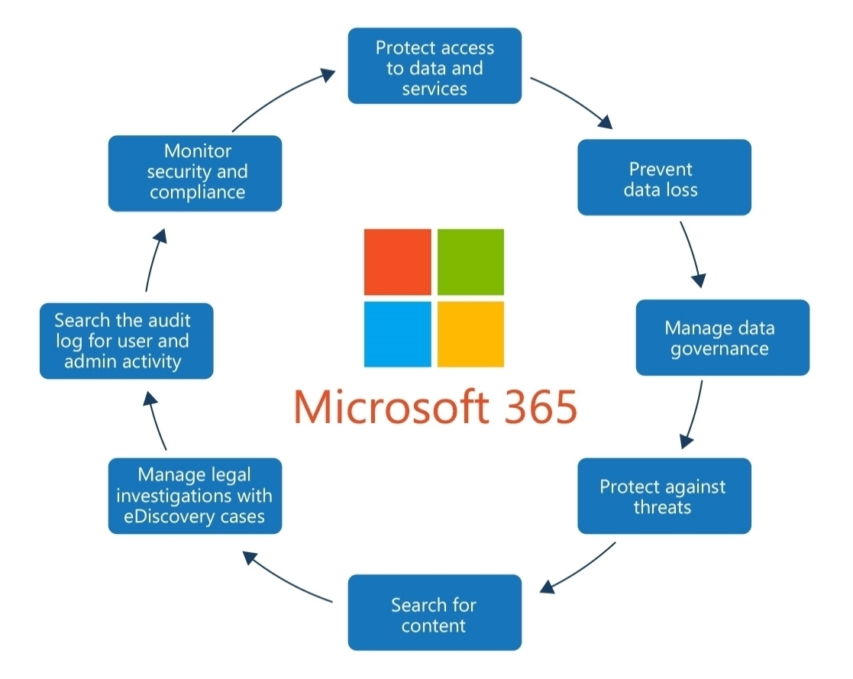
Plan for security and compliance in Microsoft 365
Notes:
Simplify regulatory compliance with Microsoft Purview Compliance Manager – YouTube – 15 minutes
Importance of security and compliance: Protecting data and meeting standards.
Steps for planning security and compliance:
Review information protection capabilities in Microsoft 365.
Check Secure Score for initial assessment.
Plan access protection for identity and devices.
Plan data protection based on sensitivity.
Utilize Microsoft Purview compliance portal.
Use recommended security configurations.
Microsoft Purview compliance portal: Centralized control for data governance.
Admin centers and dashboards: Manage security and compliance settings.

Slide 7
Plan your beginning compliance tasks in Microsoft Purview
Prioritize compliance: Manage, protect, and minimize risks.
Four roles provide access to assessments:
Reader
Contributor
Assessor
Administrator
Understand compliance state: Utilize Microsoft Purview Compliance Manager
Monitor and protect sensitive data: Labels, policies, and activity tracking
Notes:
Prioritize compliance tasks in Microsoft Purview:
Manage and monitor data.
Protect information.
Minimize insider risks.
Importance of adapting compliance processes:
New collaboration and connectivity methods.
Identify and manage compliance risks.
Task 1: Configure compliance permissions:
Assign roles for access control.
Manage access to the compliance portal.
Task 2: Know your state of compliance:
Understand current compliance level.
Utilize Microsoft Purview Compliance Manager.
Task 3: Enable auditing for your organization:
Enable audit logging for compliance investigations.
Retain activity logs for analysis.
Task 4: Create policies for compliance alerts:
Utilize built-in and custom alert policies.
Monitor compliance-related activities.
Task 5: Classify and protect sensitive data:
Use sensitivity labels for data protection.
Enforce usage restrictions and encryption.
Task 6: Configure retention policies:
Decide content retention or deletion.
Implement policies for multiple services.
Task 7: Configure sensitive information and offensive language policies:
Detect and remediate inappropriate communications.
Scan for sensitive information and keywords.
Task 8: Monitor sensitive items and activities:
Use content explorer for labeled items.
Utilize activity explorer for monitoring.

Slide 8
Manage your compliance with Compliance Manager
Dashboard provides at-a-glance view of organization’s compliance posture
Displays overall compliance score, key improvement actions, and affecting solutions
Score breakdown provides detailed view in categories and assessments
Compliance Manager offers pre-built templates for assessments
Templates are frameworks for creating assessments in Compliance Manager
Notes:
Compliance Manager in Purview: Simplifies compliance tasks.
Steps in compliance journey:
Inventory data protection risks.
Manage control implementation complexities.
Stay up-to-date with regulations and certifications.
Report to auditors.
Features of Compliance Manager:
Prebuilt and custom assessments.
Workflow capabilities for risk assessments.
Step-by-step guidance and compliance score.
Manage compliance with ease: Simplify, assess, and track compliance activities.

Slide 9
Manage your compliance with Compliance Manager (cont.)
Assessment progress and control status can be monitored on the details page
Control information available on controls tab
Improvement actions and Microsoft actions tabs available
Customizable assessment templates for specific compliance needs
Notes:
Assessment progress and control status can be monitored on the details page:
Compliance Manager provides detailed information on the progress of assessments and the status of controls within each assessment.
Users can easily track the completion of improvement actions and measure their organization's compliance progress.
Control information available on controls tab:
The controls tab in Compliance Manager offers comprehensive information about the various types of controls, including Microsoft managed controls, customer managed controls, and shared controls.
Users can access details about system configuration, organizational processes, and responsible individuals for meeting specific regulatory requirements.
Improvement actions and Microsoft actions tabs available:
Compliance Manager offers dedicated tabs for improvement actions and Microsoft actions.
Users can view and manage improvement actions that need to be implemented to enhance compliance.
Microsoft actions, which are managed by Microsoft, are also displayed separately, providing organizations with a comprehensive view of their compliance tasks.
Customizable assessment templates for specific compliance needs:
Ability to create assessments tailored to unique requirements.
Flexibility to modify templates or build custom assessments.

Slide 10
Examine the Compliance Manager dashboard
Compliance Manager dashboard:
Score
Actions
Visibility
Centralize and manage improvement actions for regulatory alignment
Solutions tab: Points, remaining actions, and solution overview
Assessments and alerts: Progress, templates, and effective management
Gain visibility into compliance status with Compliance Manager dashboard
Notes:
Microsoft Purview Compliance Manager dashboard:
Current compliance score visibility.
Attention areas identification.
Guidance to key improvement actions.
Screenshot examples:
Top portion: overall compliance score and key improvement actions.
Bottom portion: compliance score breakdown by category.
Filtering the dashboard view for specific criteria.
Improvement actions tab:
Detailed list of managed improvement actions.
Implementation guidance and solution links.
Solutions tab:
Breakdown of earned and potential points by solution.
Remaining improvement actions for each solution.
Assessments tab:
Summary of set up assessments.
Progress and completion status.
Assessment templates tab:
List and details of available templates.
Creation, export, and modification options.
Alerts tab:
View and manage generated alerts.
Details of triggering events and actions.
Alert policies tab:
View and manage alert policies.
Edit, activate, and delete options.

Slide 11
Analyze the Microsoft Compliance score
Compliance Manager assigns scores based on action types
Mandatory actions have higher assigned scores
Preventative actions have higher scores than detective or corrective actions
Compliance Manager calculates scores accurately for implementation
Notes:
Compliance Manager assigns scores based on action types.
Mandatory actions carry higher assigned scores.
Preventative actions have higher scores than detective or corrective actions.
Discretionary actions have lower assigned scores.
Compliance Manager calculates scores accurately for implementation and testing.

Slide 12
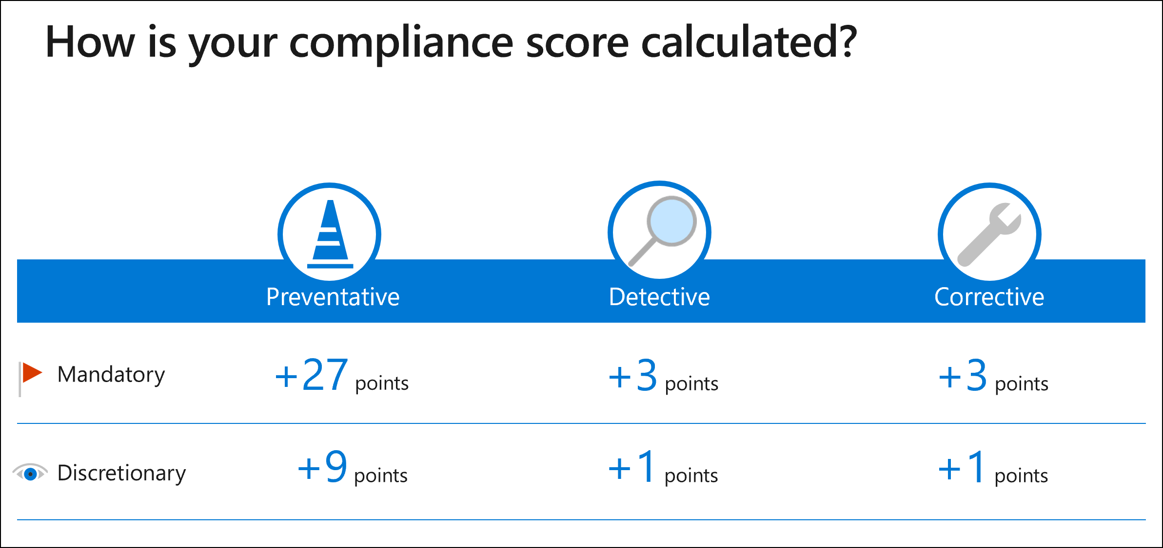
Analyze the Microsoft Compliance score (cont.)
Notes:
Compliance score is calculated based on completion of improvement actions within controls.
Improvement action score affects the overall compliance score, considering the potential risk involved.
Control score is determined by the sum of points earned from completed improvement actions within the control.
Assessment score is the sum of control scores, reflecting the organization's compliance progress.
Compliance Manager assigns points to Microsoft actions and technical actions once, and nontechnical actions per group implementation.
Mandatory and discretionary actions contribute to the compliance score differently based on their assigned values.
Preventative, detective, and corrective actions are assessed with varying scores, depending on their nature and risk level.

Slide 13
Search for content in the Microsoft Purview compliance portal

Slide 14
Agenda: Search for content in the Microsoft Purview compliance portal
Plan for a search
View and export search results
Configure search permissions filtering
Search for items from a third-party data source

Slide 15
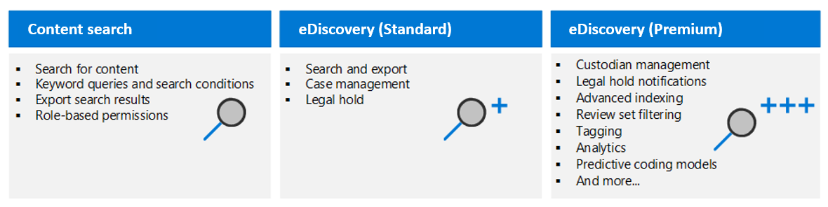
Explore Microsoft Purview eDiscovery solutions
Notes:
Content Search:
Search and export content across Microsoft 365 data sources.
Export search results to a local computer.
eDiscovery (Standard):
Create cases, assign managers, and associate searches and exports.
Place legal holds and manage custodians and notifications.
Access review sets, support for cloud attachments and SharePoint versions, and other advanced features.
Filter, tag, and analyze content to streamline the review process.
Use predictive coding models to prioritize relevant items.
eDiscovery (Premium):
Includes all eDiscovery (Standard) capabilities.
Manage custodians, notifications, and advanced indexing.
Utilize review sets, apply tags, and employ analytics.
Leverage predictive coding models to prioritize relevant content.
Track long-running jobs and export documents to customer-owned Azure Storage.

Slide 16
Create a content search
Consider the following questions when designing a content search:
Who should run the search?
What type of search should be used? (e.g., New search, Guided search, Search by ID list)
What keywords should be used to for the search?
What conditions should be used? (e.g., data type, sender, date, subject)
Should the search be conducted across all or specific locations? (e.g., SharePoint, Microsoft Teams)
Notes:
Use Content search in Microsoft Purview compliance portal to search for email, documents, and instant messaging conversations.
Search content in Exchange Online, SharePoint Online, OneDrive for Business, Teams, Microsoft 365 Groups, and Yammer Groups.
Limit access to the Content search tool to administrators, compliance officers, or eDiscovery managers.
Consider who should create and run the content search, the type of search to create, and the keywords and conditions to use.
Follow the steps to create and run a content search, including naming the search, selecting content locations, defining search conditions, and submitting the search.

Slide 17
View the search results and statistics
Preview search results to verify expected outcomes when running a content search
Preview up to 1,000 items randomly
Limit preview to 100 items per location
Preview only emails for mailboxes and documents for sites
Content search provides estimated result statistics:
Summary of the search results
Query statistics
Notes:
When you run a content search, you can preview a sample of the search results to determine if the search is returning the expected results
A maximum of 1,000 randomly selected items are available to preview
A maximum of 100 items from a single content location (a mailbox or site) can be previewed
For mailbox items, only email messages are available to preview
For site items, only documents are available to preview
After running a content search, an organization can view the following statistics about the estimated search results:
A summary of the search results
The query statistics
The number of content locations with items that match the search query
The identity of content locations that have the most matching items
If an organization uses a keyword list when it creates or edits a search query, it can get enhanced statistics that show how many items match each keyword or keyword phrase
These statistics can help it quickly identify which parts of the query are the most (and least) effective

Slide 18
Export the search results and search report
Export search results locally
Prerequisites to exporting search results include:
Export management role
Microsoft Edge to run the eDiscovery Export Tool
Connect to Azure endpoint before downloading
Notes:
After an organization successfully runs a Content search, it can export the search results to a local computer
When you export email results, they're downloaded to your computer as PST files
When you export content from SharePoint and OneDrive for Business sites, copies of the native Office documents are exported
Prerequisites to exporting search results include:
The user exporting the search results must be assigned the Export management role
Microsoft Edge must be used to run the eDiscovery Export Tool (Internet Explorer 11 is no longer supported to export search results)
Organizations should ensure they can connect to the endpoint in Azure, which temporarily stores the exported data before it’s downloaded to the local computer
Additional export considerations include:
Automating the export or download processes isn’t supported by Microsoft and should be avoided
To improve performance when downloading search results, consider dividing searches that return a large set of results into smaller searches

Slide 19
Configure search permissions filtering
Configure filtered search permissions for eDiscovery managers to search a subset of mailboxes and sites in Microsoft 365
Use recipient filters to limit search results
Create filters to specify searchable mailbox or site content
Notes:
Filtered search permissions can be configured to allow an eDiscovery manager to search only a subset of mailboxes and sites in a Microsoft 365 organization
Permissions filtering allow the eDiscovery manager to search only for mailbox or site content that meets a specific search criterion
Search permissions filtering is configured by creating a filter that uses a supported recipient filter to limit which mailboxes can be searched
Filters can be created to specify what mailbox or site content can be searched

Slide 20
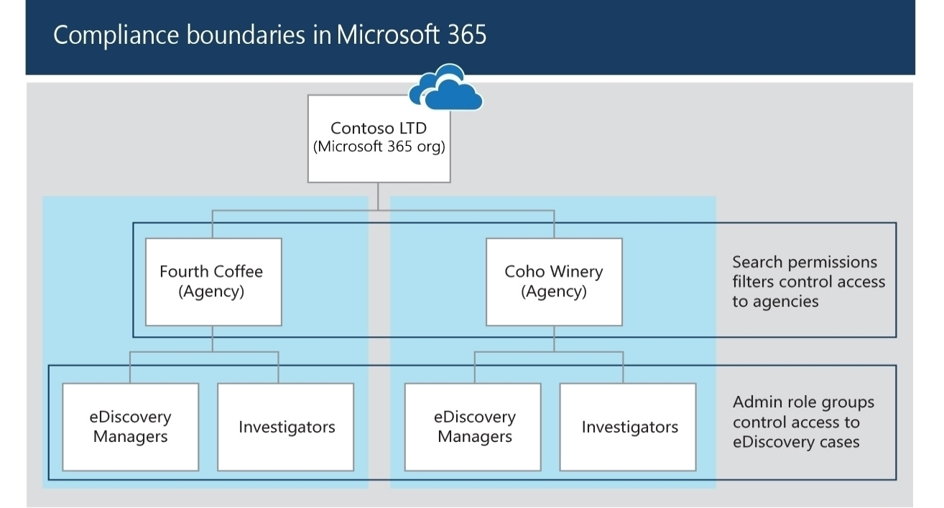
Configure search permissions filtering (continued)
Notes:
Search permissions filtering allows eDiscovery managers to search specific mailboxes and sites.
Filters limit searches based on location, department, or specific properties.
Filters apply to Microsoft Purview compliance portal search features.
Users with search permissions can search, preview, export, and purge content.
Filters create compliance boundaries within an organization.
PowerShell cmdlets manage search permissions filters.
Requirements: Organization Management role group membership, PowerShell module connection.
No limit on filters, but a search query has a maximum of 100 conditions.
Example syntax for creating filters is provided.
Knowledge check verifies understanding.

Slide 21
Search for and delete email messages
Use Content search to delete high-risk email messages from all Exchange mailboxes
Deletion process:
Max 10 items/mailbox can be removed at once
Identify dangerous attachments, viruses, phishing messages, or sensitive data
Max 50,000 mailboxes in a search for search and purge action
Connect to Security and Compliance PowerShell module
Create Content Search and delete messages
Notes:
An organization can use the Content search feature to search for and delete email messages from all mailboxes in its Exchange deployment
This process can help you find and remove potentially harmful or high-risk email, such as:
Messages that contain dangerous attachments or viruses
Phishing messages
Messages that contain sensitive data
When deleting email messages:
A maximum of 10 items per mailbox can be removed at one time
50,000 is the maximum number of mailboxes in a content search that you can use to delete items by doing a search and purge action
Deleting email messages requires the following steps:
Connect to the Security and Compliance PowerShell module
Create a Content Search to find the message to delete
Delete the message

Slide 22
Manage Microsoft Purview eDiscovery (Standard)

Slide 23
Agenda: Manage Microsoft Purview eDiscovery (Standard)
The basic workflow of eDiscovery (Standard)
How to create and manage an eDiscovery case
How to search for content in a case and then export that content

Slide 24
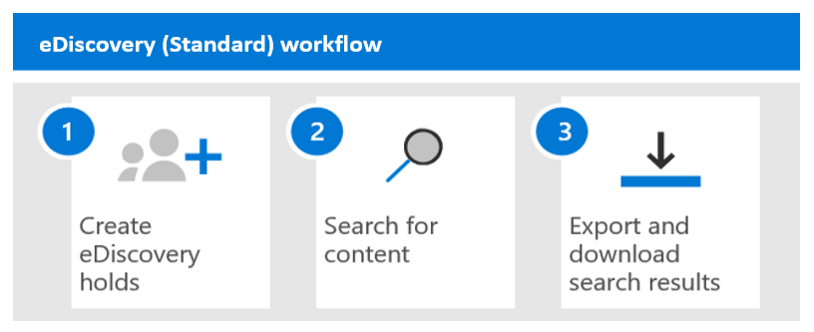
Explore Microsoft Purview eDiscovery solutions
Microsoft Purview eDiscovery (Standard) helps create cases to identify, hold, and export content from mailboxes and sites.
eDiscovery (Standard) enhances Content search by enabling organizations to create eDiscovery cases, assign managers, associate searches and exports with a case, and place a hold on relevant content locations.
Notes:
Microsoft Purview eDiscovery (Premium) enables custodian management and content analysis of cases.
eDiscovery (Standard) builds on Content search functionality by:
Enabling organizations to create eDiscovery cases and assign eDiscovery managers to specific case
Associating searches and exports with a case
Placing an eDiscovery hold on content locations relevant to a case

Slide 25
Implement Microsoft Purview eDiscovery (Standard)
Deploying eDiscovery (Standard) requires no action. However, before users can use it to search, export, and preserve content, an IT admin or eDiscovery manager must complete the following prerequisite tasks:
Step 1: Verify and assign appropriate licenses
Step 2: Assign eDiscovery permissions
Step 3: Create an eDiscovery (Standard) case
Step 4 (optional): Add members to an eDiscovery (Standard) case

Slide 26
Create eDiscovery holds
An organization can use a Microsoft Purview eDiscovery (Standard) case to create holds
Holds preserve content relevant to a case, such as mailboxes, OneDrive, Teams, and 365 Groups
Holds can be defined by selecting an infinite hold, query-based hold, or date range
Holds remain in place until the organization removes the content location from the hold or deletes the hold
Notes:
Holds preserve content that may be relevant to a case, such as:
Exchange mailboxes and OneDrive for Business accounts of people being investigated in a case
The mailboxes and sites that are associated with Microsoft Teams, Microsoft 365 Groups, and Yammer Groups
When content locations are placed on hold, the content is preserved until the organization either:
Removes the content location from the hold
Deletes the hold
When creating a hold, you must define the scope of the content being placed on hold by selecting one of the following options:
Create an infinite hold where all content in the specified locations is placed on hold
Create a query-based hold where only the content in the specified locations that matches a search query is placed on hold
Specify a date range to preserve only the content that was sent, received, or created within that date range

Slide 27
Search for content in a case
To search for content in a case, create the case and place the relevant people on hold.
Create and run one or more searches for relevant content.
Searches associated with an eDiscovery (Standard) case are listed on the Searches page and can only be accessed by case members.
When defining search conditions, specify keywords, message or document properties, use the Show keyword list to view keyword statistics, and add conditions to refine the results.
Notes:
To search for content in a case, you must first:
Create the case in the Microsoft Purview compliance portal
Place the people of interest in the case on hold
You can then create and run one or more searches for content relevant to the case
Searches associated with an eDiscovery (Standard) case are NOT listed on the Content search page in the Microsoft Purview compliance portal
Instead, they’re listed on the Searches page of the eDiscovery (Standard) case the searches are associated with
As a result, searches associated with a case can only be accessed by case members
When defining the conditions of your search, you can:
Specify keywords, message properties such as sent and received dates, or document properties such as file names or the date that a document was last changed
Select the Show keyword list option and type a keyword in each row in order to display statistics showing how many items match each keyword
Add search conditions to narrow a search and return a more refined set of results

Slide 28
Export content from a case
After successfully running a search that’s associated with a Microsoft Purview eDiscovery (Standard) case, you can export the search results
Export mailbox items as PST files or individual messages, and SharePoint/OneDrive content as native document copies
Additional exported files include Results.csv and a manifest file
Results are stored in Azure cloud, and must be downloaded within 14 days of creating the export job
Notes:
After successfully running a search that’s associated with a Microsoft Purview eDiscovery (Standard) case, you can export the search results
When search results are exported, mailbox items are downloaded in PST files or as individual messages
When content from SharePoint and OneDrive for Business sites are exported, copies of native Office documents and other documents are exported
The following additional files are exported:
A Results.csv file that contains information about every item that's exported
A manifest file (in XML format) that contains information about every search result
After the export is started, the search results are transferred to a Microsoft-provided Azure storage location in the Microsoft cloud
Exported search results must be downloaded within 14 days after the export job was created

Slide 29
Close, reopen, and delete a case
Close a case
Reopen a case
Delete a case
When a legal case or investigation supported by an eDiscovery (Standard) case is completed, the case can be closed
Closing a case turns off holds associated with it, but you can still edit the case
Reopening a closed case doesn’t automatically reinstate holds; they must be manually turned back on
To delete a case, all associated eDiscovery holds must be deleted first
Deleting a case also deletes all associated searches and exports
Deleted cases can’t be reopened
Notes:
When the legal case or investigation supported by an eDiscovery (Standard) case is completed, the case can be closed
When a case is closed:
If the case contains any eDiscovery holds, they'll be turned off
Closing a case only turns off the holds that are associated with that case
You can edit a case after it's closed
When an organization reopens a closed case, any eDiscovery holds that were in place when the case was closed aren't automatically reinstated
If an organization wants to reinstate any of these holds, it must manually turn them back on after reopening the case
Before you can delete a case (whether it's active or closed), you must first delete all eDiscovery holds associated with the case
When an organization deletes a case, all searches and exports in the case are deleted
You can't reopen a deleted case

Slide 30
Manage Microsoft Purview eDiscovery (Premium)

Slide 31
Agenda: Manage Microsoft Purview eDiscovery (Premium)
Set up Microsoft Purview eDiscovery (Premium)
Manage Purview eDiscovery (Premium) Cases
Manage custodians and non-custodial data sources
Analyze Case Content & Reduce Result Sets

Slide 32
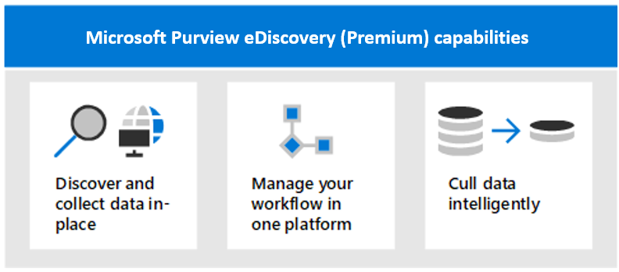
Explore Microsoft Purview eDiscovery (Premium)
Microsoft Purview eDiscovery (Premium) discovers data within Microsoft 365 and reduces reliance on other solutions.
It offers an end-to-end workflow to preserve, collect, review, analyze, and export content for internal and external investigations.
Legal teams can manage the legal hold notification workflow and communicate with custodians involved in a case.
Notes:
Microsoft 365's advanced discovery solution, Microsoft Purview eDiscovery (Premium), enables organizations to discover data at the source and stay within their Microsoft 365 security and compliance boundary
eDiscovery (Premium) can help organizations reduce the number of eDiscovery solutions they need to rely on
eDiscovery (Premium) provides an end-to-end workflow to preserve, collect, review, analyze, and export content that’s responsive to your organization’s internal and external investigations
eDiscovery (Premium) enables legal teams to manage the entire legal hold notification workflow to communicate with custodians involved in a case

Slide 33
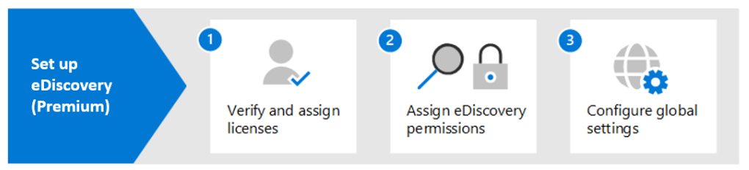
Implement Microsoft Purview eDiscovery (Premium)
Microsoft Purview eDiscovery (Premium) provides an end-to-end workflow to preserve, collect, review, analyze, and export data that’s responsive to an organization’s internal and external investigations

Slide 34
Create and manage an eDiscovery (Premium) case
Microsoft Purview eDiscovery (Premium) is designed for critical eDiscovery processes and can manage cases with over 40 million items
eDiscovery (Premium) offers benefits for collection, review, and export
In the eDiscovery (Premium) case format, organizations can collect up to 1 TB of data, review up to 1 TB of pre-expansion content, and export up to 5 million documents or 500 GB, whichever is smaller
Notes:
Establish permissions and create a case interactive guide - Establish permissions and create a case with Microsoft Purview eDiscovery (Premium) (cloudguides.com) – 10 minutes
Microsoft Purview eDiscovery (Premium) is typically used for critical eDiscovery processes
eDiscovery (Premium) cases are designed to help accommodate significant increases in case size, both for total data volume and the total number of items
It can manage cases that contain over 40 million items
The benefits of creating and managing cases in eDiscovery (Premium) include:
Collection. In the eDiscovery (Premium) case format, organizations can collect up to 1 TB of data for a single collection
Review. Each review set will support up to 1 TB of pre-expansion content. Other metadata is available for filters and queries including Team name, channel name, and conversation name for Teams content
Export. An organization can export large sets of content in a single export job. The eDiscovery (Premium) case format can export 5 million documents or 500 GB, whichever is smaller in an export job

Slide 35
Manage custodians and non-custodial data sources
Custodians are responsible for identifying, preserving, and collecting relevant content during a legal investigation
Microsoft Purview eDiscovery (Premium) offers a built-in tool for managing custodians and identifying relevant data sources
Custodians can be added and managed in four steps: Identify them, choose their data locations, configure hold settings, and review and complete the process
Notes:
Identify and preserve data sources with Microsoft Purview eDiscovery (Premium) (cloudguides.com) – Interactive Guide – 15 minutes When an organization responds to a legal investigation, the people who are responsible for identifying, preserving, and collecting potentially relevant content are known as custodians
An organization can use the built-in custodian management tool in Microsoft Purview eDiscovery (Premium) to coordinate its workflows around managing custodians and identifying relevant, custodial data sources associated with a case
Custodians can be added to and managed in eDiscovery (Premium) cases in four steps:
Identify the custodians
Choose custodian data locations
Configure hold settings
Review the custodians and complete the process

Slide 36
Analyze case content
With a large number of collected documents, reviewing them all can be difficult.
Microsoft Purview eDiscovery (Premium) provides the following tools to analyze the documents:
Near duplicate detection
Groups similar documents for efficient review.
Speeds up the review process by reducing the amount of time spent reading each document.
Email threading
Captures the last message of an email thread with all previous messages.
Enables reviewers to focus on the last message and its context, improving efficiency.
Themes
Themes functionality identifies common themes across documents in a review set.
This feature helps to understand the presence of ideas and the documents that talk about them.
Notes:
Manage and review case content interactive guide - Manage and review case content with Microsoft Purview eDiscovery (Premium) (cloudguides.com) – 15 minutes
Near duplicate detection
Groups textually similar documents together to help an organization make its review process more efficient
Enables a reviewer to take just a fraction of the time that it would have taken to read all documents cover to cover
Email threading
The last message in an email thread typically includes the contents of all the preceding messages
Email threading identifies such messages so that reviewers can review a fraction of collected documents (i.e. the last message) without losing any context
Themes
Themes functionality analyzes documents with text in a review set to parse out common themes that appear across all the documents. It identifies:
Which ideas are present in the sets
Which documents talk about those ideas

Slide 37
Manage Microsoft Purview Audit (Standard)

Slide 38
Agenda: Manage Microsoft Purview Audit (Standard)
Purview Audit: Standard vs. Premium
Search Audited Activities in Purview Audit (Standard)
Implement Audit Log Searching in Audit (Standard)
Resolve Support Issues via Audit Log Search

Slide 39
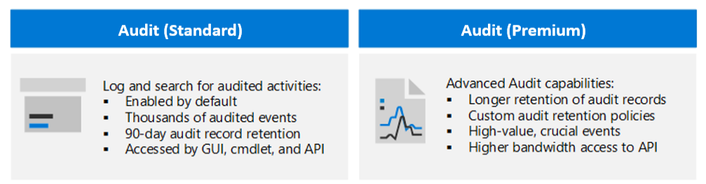
Explore Microsoft Purview Audit solutions
Notes:
Audit (Standard)
Microsoft Purview Audit (Standard) provides organizations with the ability to log and search for audited activities
It enables an organization to power its forensic, IT, compliance, and legal investigations
Audit (Premium) Audit (Premium) builds on the capabilities of Microsoft Purview Audit (Standard) by adding advanced auditing functionality

Slide 40
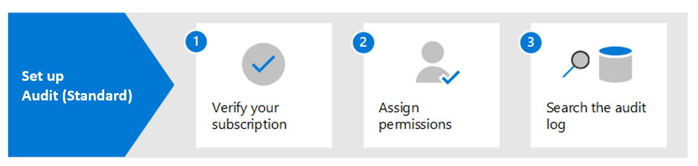
Implement Microsoft Purview Audit (Standard)
With Audit (Standard) typically enabled by default, minimal is needed to search the log.
In Audit (Standard), audit records for audited activities are retained and searchable in the log for 90 days.
Notes:
Microsoft Purview Audit (Standard) allows searching for audit records in Microsoft 365.
Verify organizational subscriptions and user licensing for Audit (Standard).
Assign permissions to team members for accessing and searching the audit log.
Permissions can be assigned through View-Only Audit Logs or Audit Logs role in Exchange Online.
Create a custom role group and add the desired role to grant search privileges.
Search the audit log in the Microsoft Purview compliance portal.
Configure search conditions, including date and time range, activities, users, and file/folder/site.
Run the search and view audit records on the results page.
Detailed properties of selected records can be viewed in a flyout page.

Slide 41
Search the audit log
Microsoft 365 audit log enables searching for activities across services
The following steps are required to search the audit log within the Microsoft Purview compliance portal:
Run an audit log search. Configure search criteria, including start/end dates, activity type, user, file/folder name or URL.
View the search results. Displays up to 50k events in 150-event increments.
Export the search results to a file. Export results to a CSV file on local computer.
Notes:
Microsoft 365 supports an audit log so that organizations can search it for activities performed in different Microsoft 365 services
The following steps are required to search the audit log within the Microsoft Purview compliance portal:
Run an audit log search. When doing so, configure the following search criteria:
Start date and End date
Type of activities to search for
Users to display search results for
File name or folder name containing activities with the specified keyword
URL of a file or folder
View the search results. A maximum of 50,000 events will be displayed in increments of 150 events
Export the search results to a file. The results can be exported to a comma-separated value (CSV) file on a local computer

Slide 42
Export, configure, and view audit log records
Step 1: Export audit log search results
Step 2: Format the exported audit log using the Power Query Editor
Use PowerShell to search and export audit log records
Notes:
Step 1: Export audit log search results
The first step is to search the audit log and then export the results in a comma-separated value (CSV) file to your local computer
Step 2: Format the exported audit log using the Power Query Editor
The next step is where the JSON transform feature in the Power Query Editor in Excel comes into play
This feature will split each property in the JSON object in the AuditData column into its own column
Use PowerShell to search and export audit log records
You can use the Search-UnifiedAuditLog cmdlet in Exchange Online PowerShell to export the results of an audit log search to a CSV file
Follow the same procedure described in Step 2 in the student training manual to format the audit log using the Power Query editor

Slide 43
Use audit log searching to investigate common support issues
Audit log search tool helps investigate common support issues:
Find IP address for compromised accounts
Identify email forwarding setup
Track deleted email items and inbox rule creation
Investigate successful sign-in by external users
Search mailbox activities by users or delegates.
Notes:
Organizations can use the audit log search tool to help them investigate the following common support issues:
Find the IP address of the computer used to access a compromised account
Determine who set up email forwarding for a mailbox
Determine if a user deleted email items in their mailbox
Determine if a user created an inbox rule
Investigate why there was a successful sign-in by a user outside your organization
Search for mailbox activities performed by users with non-E5 licenses
Search for mailbox activities performed by delegate users

Slide 44
Manage Microsoft Purview Audit (Premium)

Slide 45
Agenda: Manage Microsoft Purview Audit (Premium)
Implement Microsoft Purview Audit (Premium)
Create audit log retention policies
Investigate Compromised User Accounts

Slide 46
Explore Microsoft Purview Audit (Premium)
Microsoft Purview Audit (Premium) includes advanced features for forensic and compliance investigations:
Available for Office 365 E5/A5/G5 or Microsoft 365 Enterprise E5/A5/G5 subscriptions
1-year retention for audit records (vs. 90 days for Audit Standard)
Access to crucial events for compromise scope determination
Higher bandwidth access for faster Office 365 Management Activity API access
Users need Audit (Premium) license for audit log generation during event performance
Notes:
Microsoft Purview Audit (Premium) provides the following advanced features designed specifically for organizations that conduct forensic and compliance investigations:
Increased audit log retention (audit records are retained for one year versus 90 days for Audit (Standard)
Access to crucial events that help determine scope of compromise
Higher bandwidth access, and thus, faster access to Office 365 Management Activity API
Audit (Premium) is available for organizations with an Office 365 E5/A5/G5 or Microsoft 365 Enterprise E5/A5/G5 subscription
Audit (Premium) helps organizations conduct forensic and compliance investigations by providing access to important events
Users must be assigned an Audit (Premium) license so that audit logs will be generated when users perform these events

Slide 47
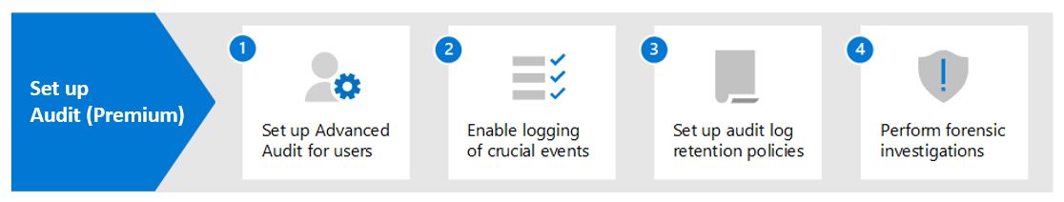
Implement Microsoft Purview Audit (Premium)
Step 1.
Begin logging MailItemsAccessed and Send events and wait up to 24 hours
Step 2.
Enable SearchQueryInitiatedExchange and SearchQueryInitiatedSharePoint events for Exchange Online and SharePoint Online searches
Step 3.
Default retention policy retains audit records for 1 year, but can be customized
Step 4.
Search Audit (Premium) log for forensic, security, and compliance investigations
Notes:
Step 1. When this step is complete, the logging of audit records for the MailItemsAccessed and Send events will begin within 24 hours
Step 2. You must enable the following Audit (Premium) events to be logged so that users can perform searches in Exchange Online and SharePoint Online:
SearchQueryInitiatedExchange
SearchQueryInitiatedSharePoint
Step 3. The default retention policy in Audit (Premium) retains Exchange, SharePoint, and Azure AD audit records for one year. This retention period can be modified by creating customized retention policies
Step 4. After completing Steps 1 and 2, you can search the audit log for Audit (Premium) events and other activities during forensic investigations of compromised accounts and other types of security or compliance investigations

Slide 48
Manage audit log retention policies
Audit log retention policies specify log retention (up to 10 years)
Microsoft Purview Audit (Premium) has a default retention policy for all orgs
Create retention policies based on specific activities or service-wide events
Use priority level to resolve conflicts between multiple retention policies
Users with Organization Configuration role can create policies in the compliance portal
Notes:
Audit log retention policies enable organizations to specify how long they want to retain audit logs
Audit logs can be retained for up to 10 years
Microsoft Purview Audit (Premium) provides a default audit log retention policy for all organizations
Retention policies can be created based on the following criteria:
All activities in one or more Microsoft 365 services
Specific activities (in a Microsoft 365 service) performed by all users or by specific users
A priority level that specifies which policy takes precedence when multiple policies exist in an organization
To create retention policies, a user must be assigned the Organization Configuration role in the Microsoft Purview compliance portal

Slide 49
Investigate compromised email accounts
A compromised user account is when an attacker gains access to and operates as a user
Microsoft 365 audits access to mail data by mail protocols and clients to help organizations investigate such cases
To conduct an investigation, organizations should:
Identify the compromised mailboxes and the timeframe of the attack
Use the MailItemsAccessed mailbox-auditing action to understand the scope of the breach and search audit records using Search-UnifiedAuditLog or Search-MailboxAuditLog cmdlets in Exchange Online PowerShell
Notes:
A compromised user account is where an attacker gains access to a user account and operates as the user
To help organizations investigate compromised email accounts, Microsoft 365 audits access to mail data by mail protocols and clients
It does so by using the MailItemsAccessed mailbox-auditing action, which can help investigators:
better understand email data breaches
identify the scope of compromises to specific mail items that may have been compromised
Organizations should complete the following steps when conducting an investigation:
Identify the mailboxes that have been compromised
Determine the time frame when the attacker had access to those mailboxes
Use the Search-UnifiedAuditLog or Search-MailboxAuditLog cmdlets in Exchange Online PowerShell to search audit records that correspond to the data breach

Slide 50
Closing Slide

Slide 51
Knowledge check
1
After a hold is turned off, a grace period (called a delay hold) is applied to content locations that were on hold. How long is this delay hold?
30 days
60 days
90days
2
After an audit log search has finished running, the search results are loaded. After a few moments, the results are displayed. How are the search results displayed?
All the results will be displayed in increments of 150 events
A maximum of 1500 events will be displayed in increments of 150 events (10 pages worth of events)
A maximum of 50,000 events will be displayed in increments of 150 events
3
Which Compliance Score component is an evaluation of a template that starts the scoring process for an organization?
A Microsoft-managed control
An assessment
A Customer-managed control

Slide 52
Monitor and investigate data and activities by using Microsoft Purview Labs

Slide 53
Lab Exercises
Exercise 1 – Explore Compliance Manager
Exercise 2 – Case investigation with eDiscovery (Standard) and content search

Slide 54
Closing slide

